Slide 1
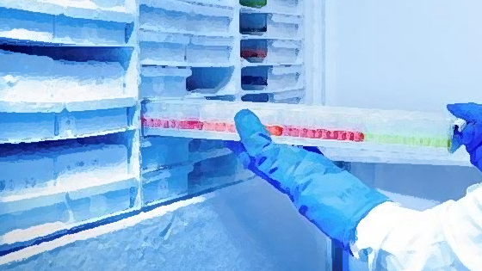
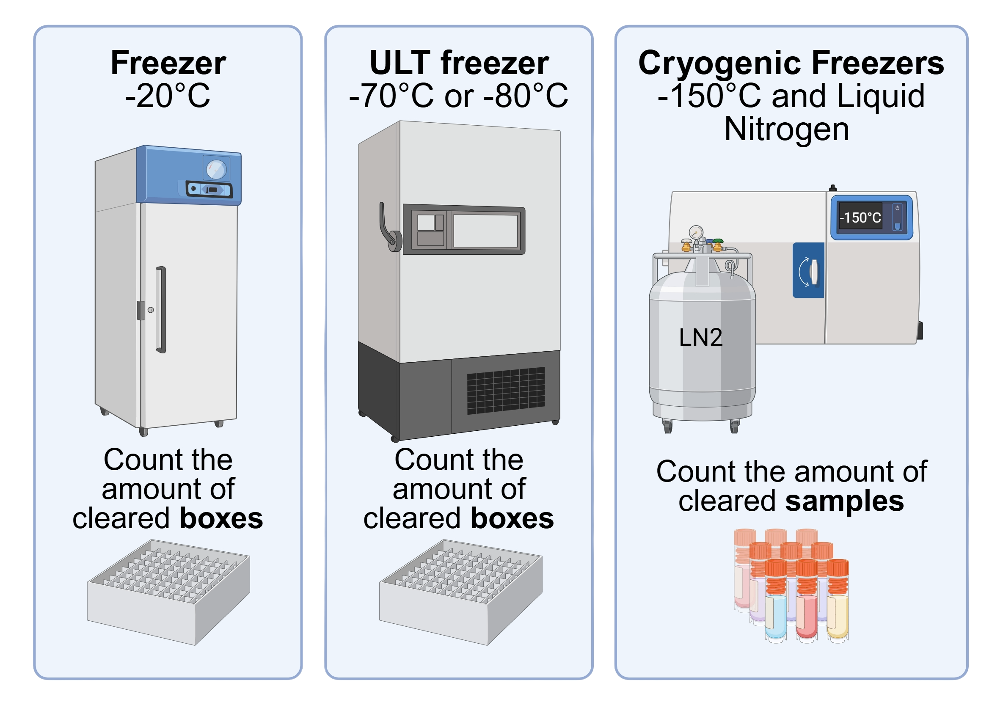
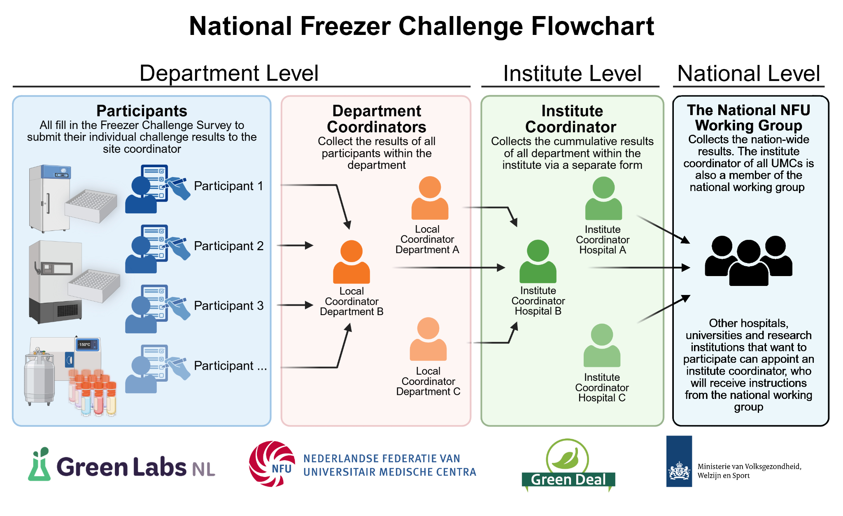
NFU werkgroep GDDZ2 – verduurzaming laboratoria presents
National Freezer Challenge 2025
1 September – 31 December
One typical single ULT freezer uses as much energy as 2-3 average households. Together, we can create a more more sustainable lab environment and save energy
We encourage laboratories to clean out and use their freezers (-20°C, -80/70°C and cryogenic freezers)
Request the questionnaire from your institute or department coordinator at [email]

Slide 2
